Slide 1
Project Funded by EU
National Capacity Building Workshop on Climate Change for EEAA Junior Staff
ورشة العمل الوطنية لبناء القدرات فى موضوعات تغير المناخ
لشباب الباحثين بجهاز شئون البيئة
Synergy Between Mitigation and Adaptation
Dr Elsyed Sabry Mansour
Senior Expert for Low Carbon Development / ENPI ClimaSouth
المنعقدة بالتعاون بين برنامج كليماساوث (الممول من الاتحاد الاوروبى) وجهاز شئون البيئة
Hotel SOFITEL, Maadi, Cairo, Jan 5-6th , 2014

Slide 2
Climate Change in ENP South Region
ENP South region is among the most arid area in the world: the IPCC indentified it as especially vulnerable to climate change because:
=> Climate change is a risk multiplier with scarcer water resources, climate sensitive agriculture, limited natural resources associated to an increasing economic development and demographic growth along the coastal zones in particular.
Notes:
2
2

Slide 3
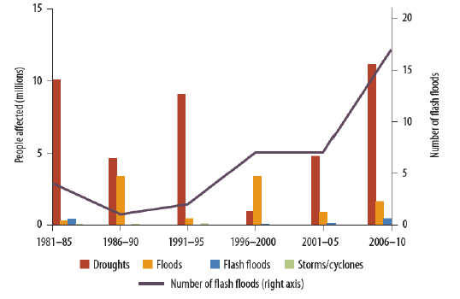
Impact of climate-related disasters across the Arab Region
More floods
Source: "Adaptation to a changing climate in the Arab Countries"
World Bank
Notes:
3
3

Slide 4
Climate change impacts
The IPCC projects (95% certainty):
2^{ₒ} C increase by 2050
4^{ₒ} C increase by 2100
Changes in precipitation patterns
Stronger winds (more sand storms)
Combined effects of temperature increase and precipitation variability will increase the occurrence of droughts
Maghreb: Droughts have increased from 1 event every 10 years in early 20th century to 5-6 events every 10 years today
Global models predict sea levels rising from:
0.1 to 0.3 m by 2050
0.1 to 0.9 m by 2100
1.0 meter sea level rise would affect:
3.2% of MENA’s population
1.5% of the regional GDP
3.3% of wetlands
Egypt: A 1.0 m sea level rise in the Nile Delta would affect 10% of the population, and 13% of Egypt’s agriculture
Notes:
The IPCC predicts a 2 degree temperature increase by 2025, and a 4 degree increase by 2100.
MENA withdraws ¾ of renewable water resources annually: The next highest level of water use is in South Asia, where only one quarter of water resources is currently being withdrawn.

Slide 5
Low carbon emissions patterns in the ENP South Region
GHG emissions differ by sectors, and from one country to another
Algeria Tunisia
Notes:
5
5

Slide 6
Low carbon emissions patterns in the ENP South Region (2)
Egypt
GHG emissions (net): | 1990: 117 MtCO2eq 2008: 288 MtCO2eq (est.) | GHG emission growth rate: | 5.1% (1990-2008)
Main emitting sectors: | Energy 61% Agriculture 16% Industrial processes 14% Waste 9%
The fastest growing sources: waste and industrial processes
Jordan
GHG emissions (net): | 1994: 13.8 MtCO2eq 2000: 20.1 MtCO2eq | GHG emission growth rate: | 6.5% (1994-2000)
Main emitting sectors: | Energy 74% Waste 13% Industrial processes 11%
Notes:
6
All data are for 2000.
Percentages are based on total net emissions.
6

Slide 7
Mitigation versus Adaptation?
Synergy is the interaction of adaptation and mitigation measures so that their combined effect is greater than the sum of their effects if implemented separately.
Notes:
7
No need for opposition: adaptation and mitigation are seen as integral parts / the 2 sides of the same coin, even if not the main objectives as such. Synergies are recognized and contribute to green growth (including low-carbon emissions) simultaneously supporting resilience-building.
7

Slide 8
Synergies : Added value
Very often, clean energy is regarded as a «mitigation» activity, while water resources management is considered as an «adaptation measure». But :
Clean energy & water resources management together offer a good example of synergy and trade-offs between mitigation and adaptation measures which could be overlooked in a strict segregation among adaptation and mitigation stand alone actions => Win Win situation
Notes:
8
8

Slide 9
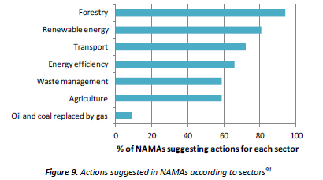
Potential sectors for synergies
Review of national priorities globally
Energy, agriculture and the water sector (including coastal management) provides relatively high potential for both mitigation and adaptation measures
Source : Scoping study on financing adaptation-mitigation synergy activities, Nordic Council of Ministers, 2013.
Notes:
9
9

Slide 10
Examples of Low carbon emissions measures boosting climate resilience
Solar energy supporting water resources sector in Jordan
Energy efficiency in the building sector in Morocco
Notes:
10
10

Slide 11
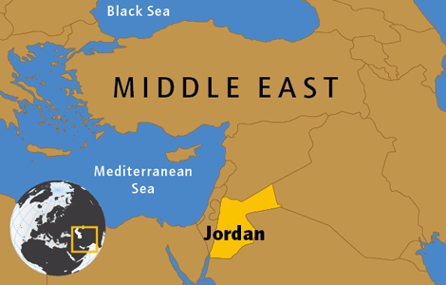
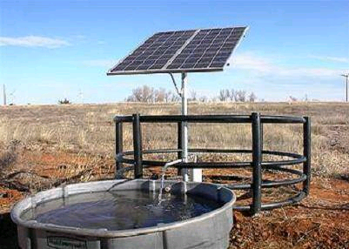
The case of the Jordan Valley
The greatest contributor to GHG emissions in Jordan is the electricity sector; the greatest climate vulnerability is water supply. The latter issue exacerbates the former: the electricity consumption for water pumping is already high, and will further grow with climate change
Jordan receives a high amount of solar radiation each year (20.4 MJ/m2) making photovoltaic electricity a viable renewable energy option. Water technologies, such as deep groundwater pumping, are very energy intensive : meeting those energy needs in a resilient, carbon-neutral manner is essential
Notes:
11
11

Slide 12
A solution: Solar Pumps project in Jordan
Low Carbon Development direct benefits: Expected CO₂ reduction:4501,575 ton CO2/year Annual Econmic Savings for 243 SWP= saving of total annual consumption of fossil fuel+electricity= 434700 JOD = $613361
Socio/economic co-benefits: Stability for residents in the Jordan Valley, encouraging farmers to adopt such actions; job creation from temporary construction jobs; gives local communities opportunity for economic development ; Increase the income of the farmers by $ 2526/unit (average unnual fuel cost)
Environmental co-benefits: Air pollution reduction thus improving health conditions
Notes:
12
12

Slide 13
Another problem: GHG emissions from Residential Buildings
In 1990, the residential, commercial and institutional buildings sector was responsible for roughly 1/3 of global energy use and associated GHG emissions (all countries together). This sector is offering a rapid deployment of new technologies to:
1)reduce energy use in building equipment (appliances, heating and cooling systems, lighting, plug loads, including office equipment);
2)reduce heating and cooling energy losses through improvements in building thermal integrity.
Notes:
13
13

Slide 14
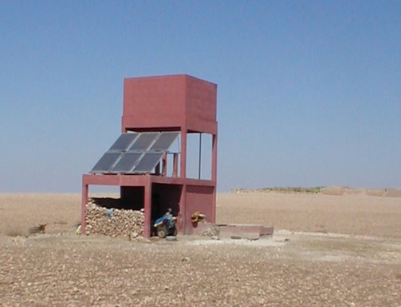
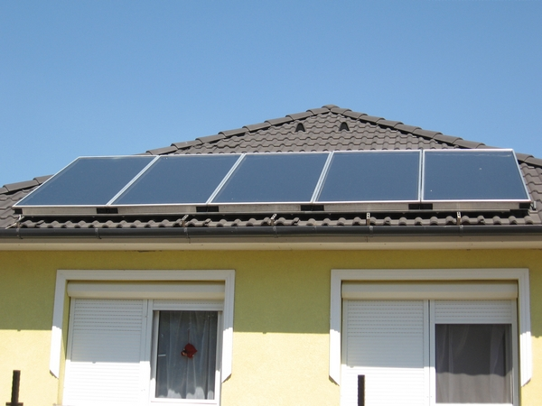
Energy Efficiency in Residential Buildings in Morocco
Objective: Adoption of measures to stimulate the uptake of solar hot water systems and accelerate the adoption of efficient lighting (CFL)
The context in Morocco:
Solar water heater market development is aiming at reaching an installed capacity of approximately 1.7 million m² by 2020.
Morocco aims to distribute some 23 million CFLs to reduce peak load.
The "20-20" initiative: households that achieve a 20% reduction in energy usage benefit from an additional 20% rebate on energy bills.
Notes:
14
14

Slide 15
A mitigation project - also contributing to resilience: Energy Efficiency Residential Buildings in Morocco
Low Carbon Development direct benefits => Mitigation
Expected CO2 reductions:
SWH = 0.45-0.9 TCO2/100 Liter/year
Incandescent light bulbs (standard) to CFL = 45 gCO₂/KWh
PV (Crystal) = 43 kg CO₂/M Wh, PV (Thin Film) = 21 kg CO₂/MWh
Sustainable development co-benefits => Climate Resilience
Social: Job opportunities (manufacturing, installation, maintenance and operation)
Economic: from energy savings (Values vary with location, orientation of modules, technology choices, size of installation actual installation and operating costs)
Environmental: Reduce air pollution, hence improving health conditions

Slide 16
Building resilience with GHG emissions reduction
Technological and non-technological responses can mitigate the amount of GHGs in the atmosphere
.
Innovative technologies are making
buildings more energy efficient,
allowing for the harnessing of renewable energy and
reducing emissions from transportation sources.
Non-technological responses include taking actions to preserve and expand carbon sinks.
natural systems that sequester carbon from the atmosphere by storing / carbon-offset (forests for example)

Slide 17
Effective climate change policy
Horizontal approach:
Low Carbon Economy Supporting Climate Resilient Society
OR
Climate Resilient Society Built on Low Carbon Economy
=> A cross-sectoral dialogue to allow implementing an effective climate change policy at various levels (national, regional, local)

Slide 18
How to move towards a closer dialogue?
Taking climate change into account at every level:
Region specific approaches: identify joint strategies taking into account the regional scale of impacts, type of risks and similar/complementary options;
National /sectoral level: better integration of climate change impacts and risk management into national agriculture, health, water resources management policies.
Local level: Local development plan at community levels to enhance resilience of vulnerable population/ecosystems.

